Slide 1

Virtual Memory
Understand the problem with direct address
Understand virtual
memory
Implement virtual memory
① Address Spaces
② VM for Memory Management
③ Address Translation
Notes:
Minh-Quoc NGHIEM
Last update: 07/12/2016

Slide 2

Physical Address
Address
Data

Slide 3

Problem
?
Process A
Notes:
Process A

Slide 4
Problem
PA 0xABC
Process A
PA 0xABC
Process B
Notes:
Process A

Slide 5
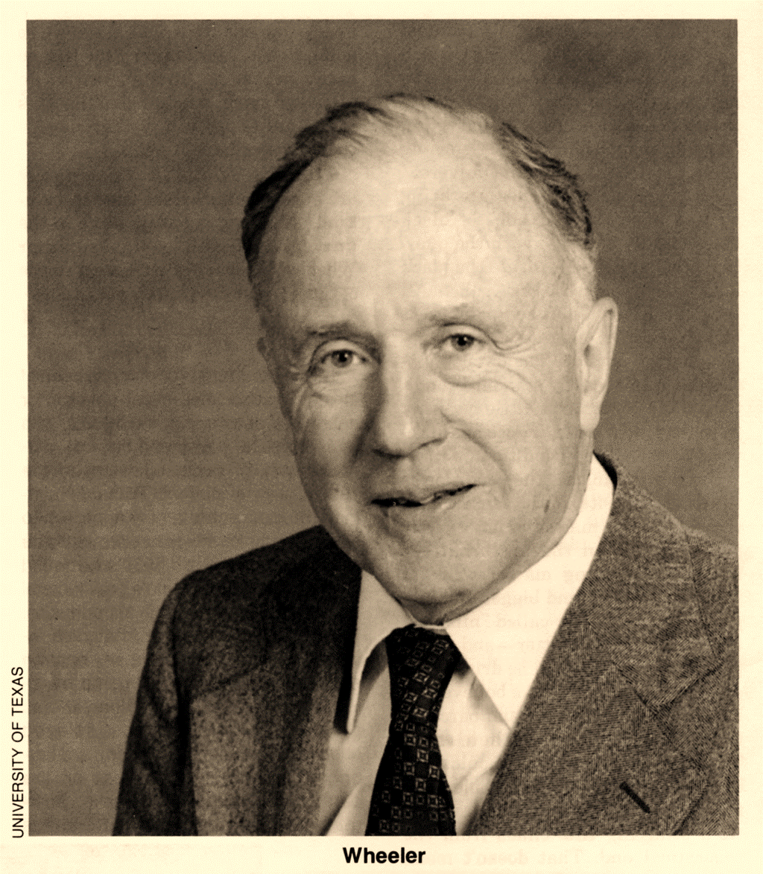

David John Wheeler
1985 Computer Pioneer Award
for assembly language programming
All problems in computer science can be solved by another level of indirection
… except of course for the problem
of too many indirections.

Slide 6
Virtual Address
PA
0x200
VA 0xABC
Process A
Virtual
Memory
VA 0xABC
PA
0x100
Process B
Notes:
Virtual Memory

Slide 7
Memory Management Unit
CPU
MMU
VA
PA

Slide 8



Address Space
Virtual
Address Space
$$≫$$
Physical
Address Space
$$\{0,1,…,N−1\}$$
$$\{0,1,…,M−1\}$$
Virtual Address
n
Physical Address
m
Notes:
n

Slide 9
Virtual Address
Number of virtual address bits (n) | Number of virtual addresses (N) | Largest possible virtual address
8
 | 2?=64K
 |  | 2³²-1=?G-1
 | 2?=256T
64
Notes:
Virtual Address Space

Slide 10
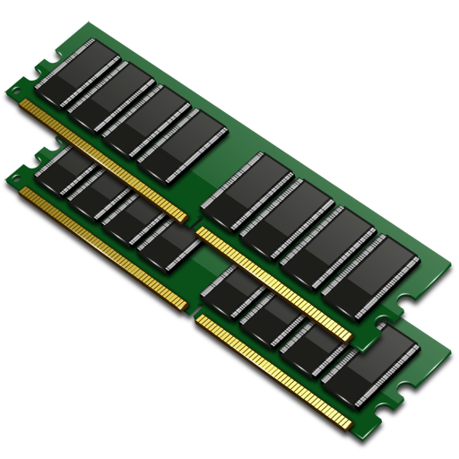


Why Virtual Memory?
Efficiency
Simplification
Protection

Slide 11
Organization
0
Empty
1
Physical pages
2
0
Unallocated
3
Cached
1
Uncached
2
…
Cached
3
Unallocated
Cached
Uncached
Uncached
Disk
…
Virtual pages
Notes:
Disk

Slide 12
Page table
0
Empty
1
Physical pages
2
0
Unallocated
3
Cached
1
Uncached
2
…
Cached
3
0 | null
1
0
1
0 | null
1
0
 | …
Unallocated
Cached
Uncached
Uncached
Page table
…
Virtual pages
Valid
Notes:
Cached

Slide 13
Page Table Entries
n | P=2^{p} | Number of PTEs
16 | 4K
16 | 8K
32 | 4K
32 | 8K

Slide 14



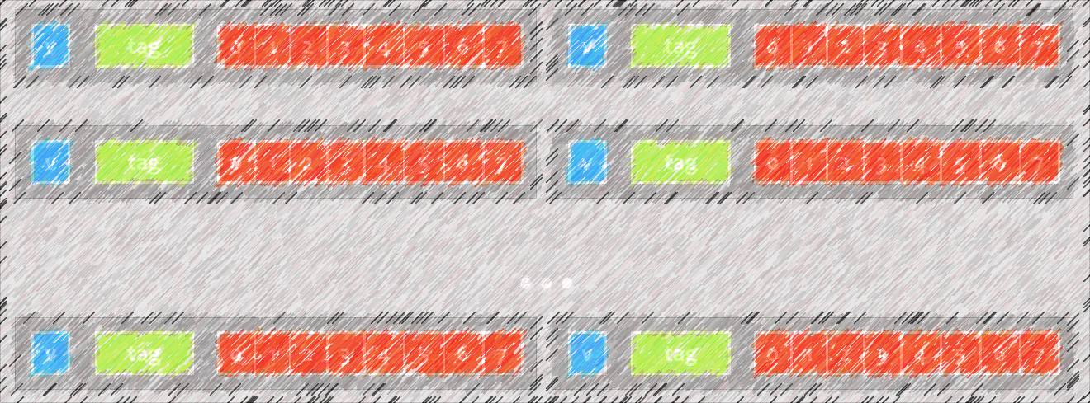
DRAM Cache
10x
slower
100,000x
slower
①
Large Page
② Fully Associative
③ Write-back
Notes:
Fully Associative

Slide 15
Allocating Pages
0
Empty
1
Physical pages
VP 0
2
0
Uncached
Unallocated
3
Cached
1
Uncached
2
…
Cached
3
0
1
0
1
0 | null
1
0
 | …
Unallocated
0 | null
1
0
1
0 | null
1
0
 | …
Cached
Uncached
Uncached
Page table
…
Virtual pages
Notes:
Cached

Slide 16
Page Hit
0
Empty
1
Physical pages
VP 1
2
0
Uncached
Unallocated
3
Cached
1
Uncached
2
…
Cached
3
0
1
0
1
0 | null
1
0
 | …
Unallocated
Cached
Uncached
Uncached
Page table
…
Virtual pages
Notes:
VP 0

Slide 17
Page Fault
0
Empty
1
Physical pages
VP 2
2
0
Uncached
Unallocated
3
Cached
1
Cached
2
Uncached
…
Cached
3
0
1
0
1
0 | null
1
0
 | …
Unallocated
0
1
1
1
0 | null
1
0
 | …
Cached
Uncached
Uncached
Page table
…
Virtual pages
Notes:
VP 0

Slide 18
Thrashing
0
1
Physical pages
VP 0
2
0
Uncached
Cached
Cached
1
3
Uncached
Cached
2
…
Cached
3
0
1
1
1
0 | null
1
0
 | …
Unallocated
1
0
1
1
0 | null
1
0
 | …
Cached
Uncached
Uncached
Page table
…
Virtual pages
Notes:
VP 0

Slide 19
Address Translation
p
Virtual Address
Virtual Page Number
Virtual Page Offset
n
Page table base
Physical Address
PP Number
Physical Page Offset
m
Identify
Page table
0
1
1
1
0 | null
1
0
 | …
Identify
byte in page
1
0
1
1
0 | null
1
0
 | …
Identify
physical address
Notes:
Identify byte in page

Slide 20
Page Hit
Data
CPU
MMU
PA
VA

Slide 21
Page Hit
Data
PTE
PTEA
Page table
CPU
MMU
PA
VA

Slide 22
Page Hit
Data
Cache
PTE
PTEA
Page table
CPU
MMU
PA
VA

Slide 23
Page Hit
Data
TLB
Cache
PTEA
PTE
Page table
CPU
MMU
PA
VA

Slide 24
Translation Lookaside Buffer
p
TLB Tag
Virtual Page Number
TLB Index
Virtual Page Offset
v
tag
PTE
v
tag
PTE
v
tag
PTE
v
tag
PTE
...
v
tag
PTE
v
tag
PTE

Slide 25
Summary
Address
Physical
Virtual
Page Hit / Page Fault
Translation Lookaside Buffer

